Slide 1


ARDDUINO-ANDROID INTENSIVE CARE UNIT/ DATA ACQUISION MONITOR

Slide 2
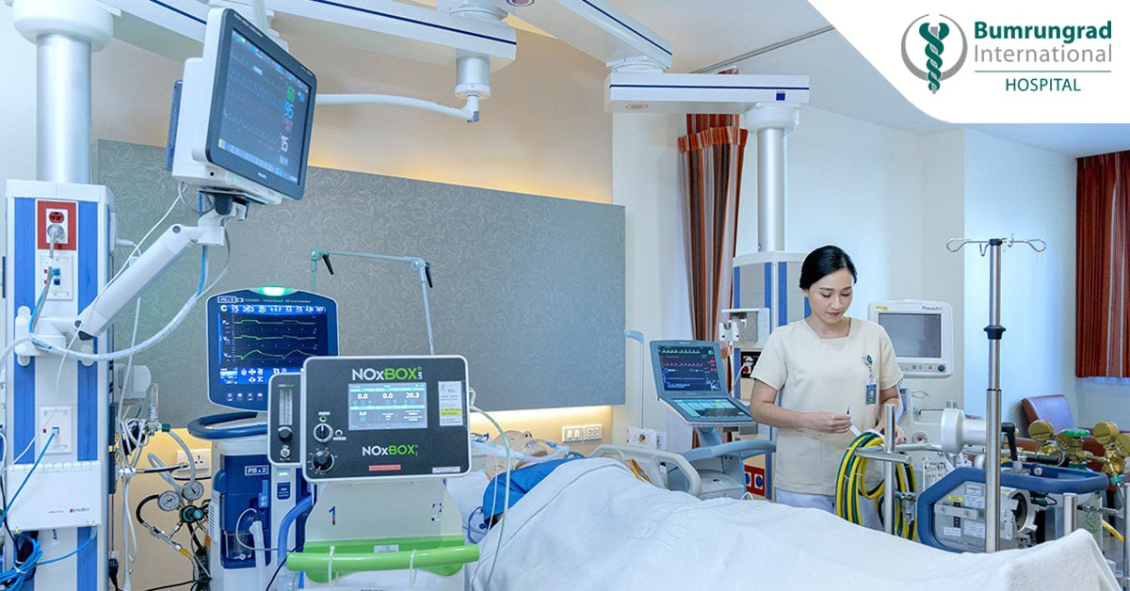
PROBLEM
Lack of low cost hospital monitors in Africa and the global south.
The average cost of a commercial monitor is over $15,000 USD.

Slide 3

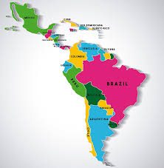
PROBLEM
Over one-billion people lack access to ICU during emergencies in rural, urban, private and public hospitals.
98 per cent of medical personnel lack mobile ICU monitors.
Lack of a comprehensive medical data acquisition system for data analytics.

Slide 4
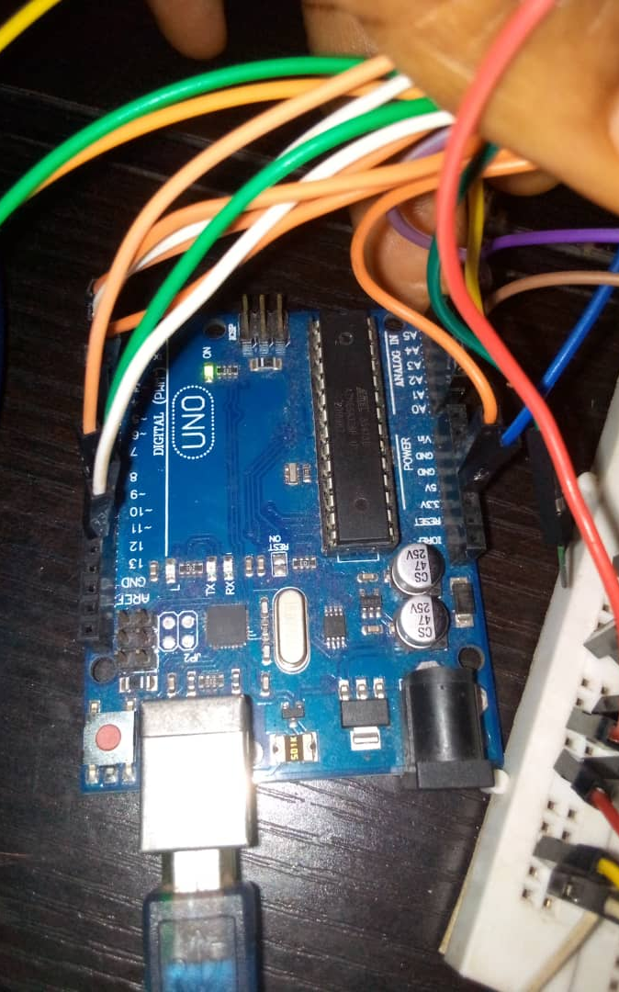
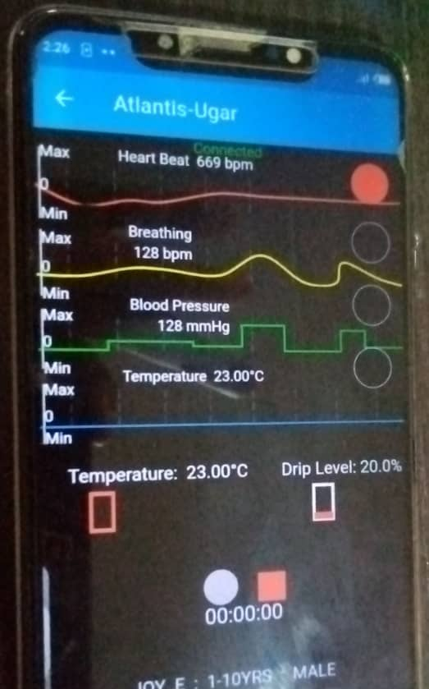
SOLUTION PEER-TO-PEER HARD/SOFTWARE
Our solution provides a low cost wireless Android-Arduino based medical data acquisition/ intensive care unit monitor.
Estimated cost of hardware/software is 100 USD.

Slide 5
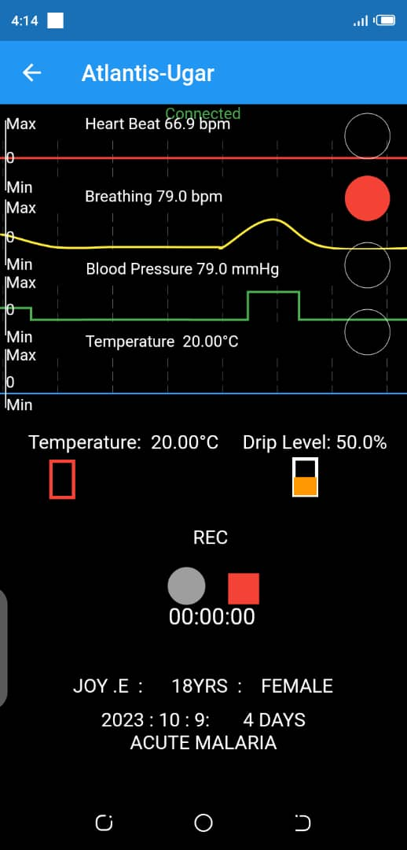
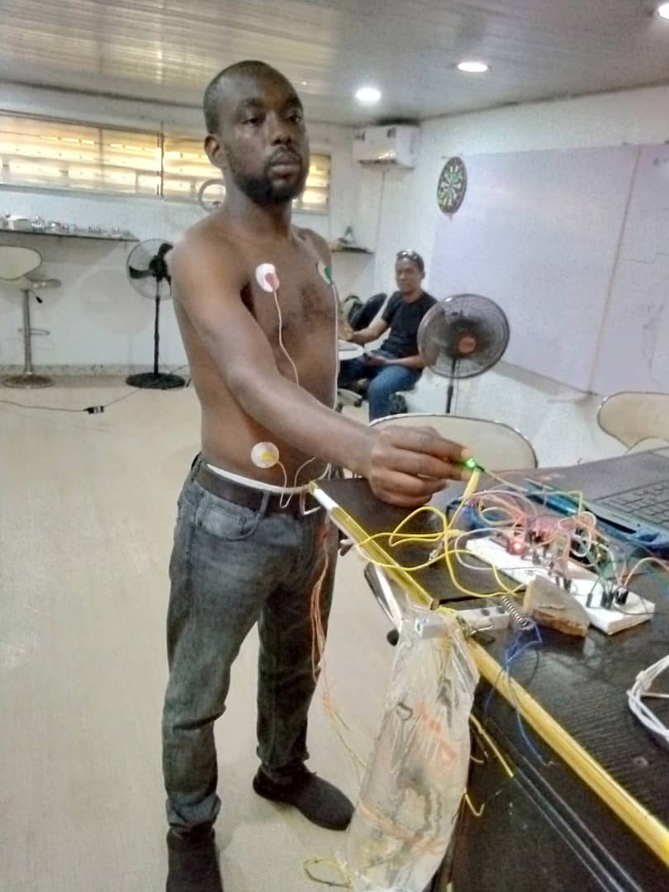
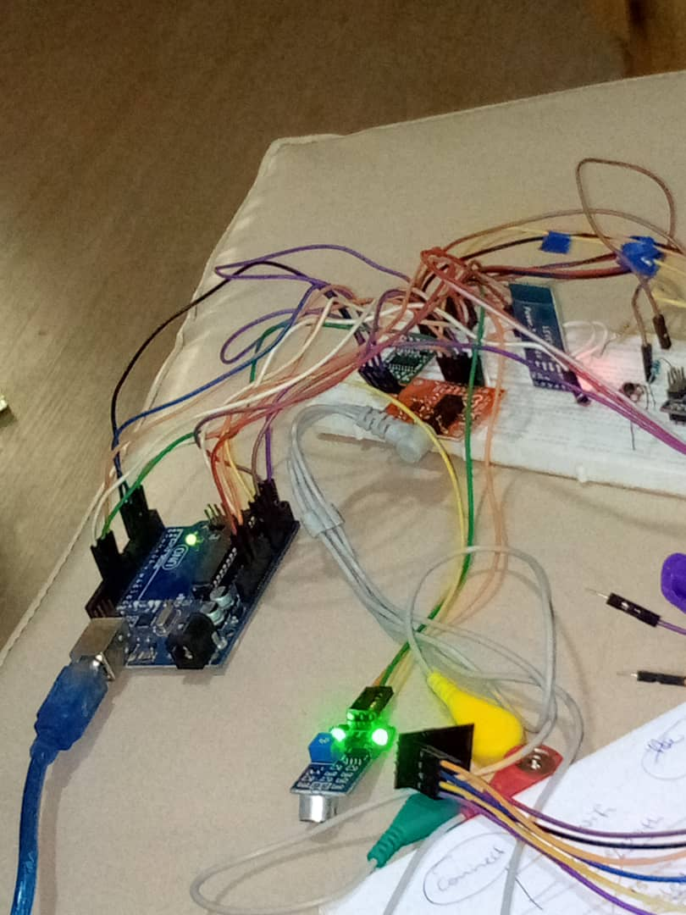
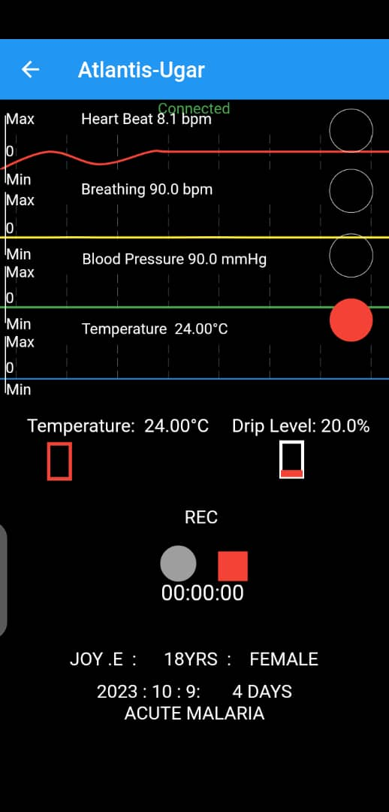
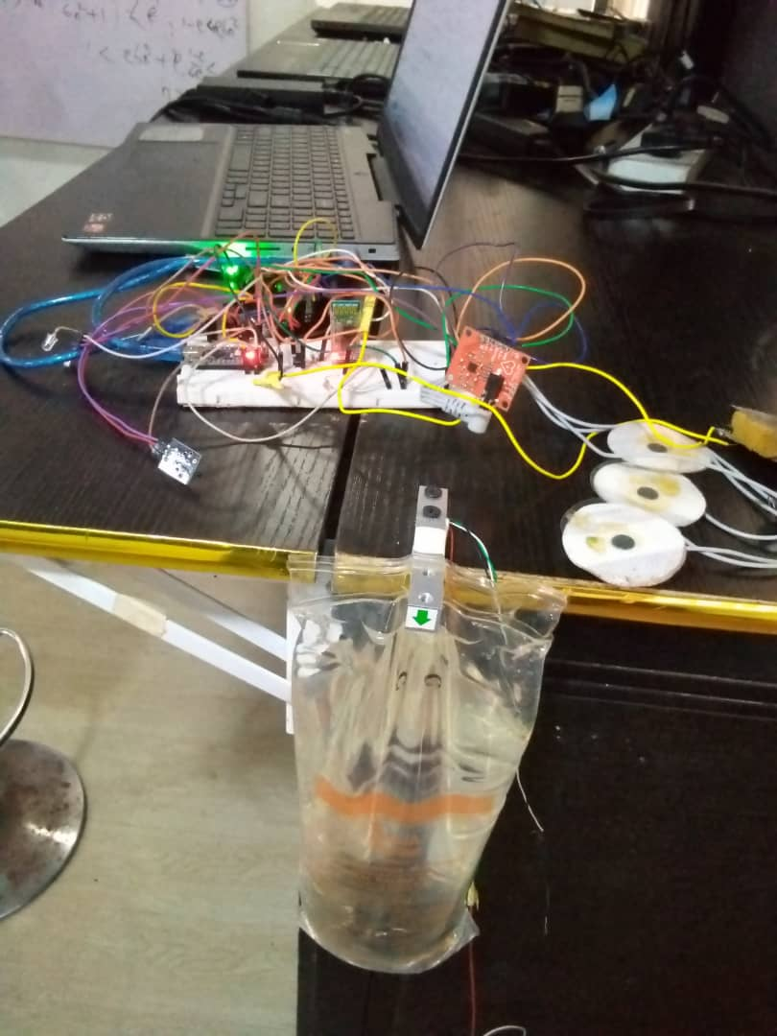
SOLUTION HARDWARE/SENSORS

Slide 6
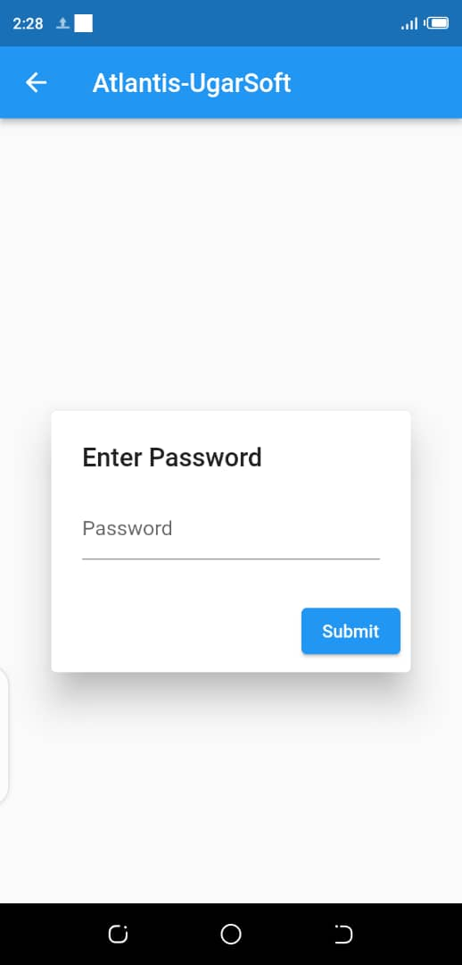
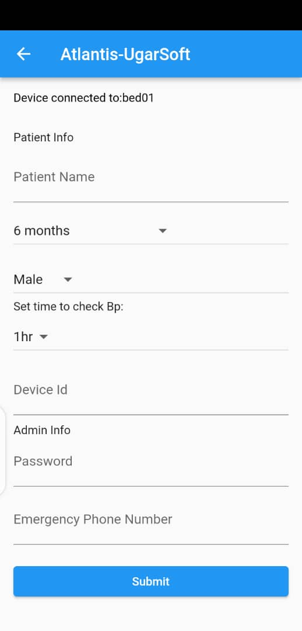
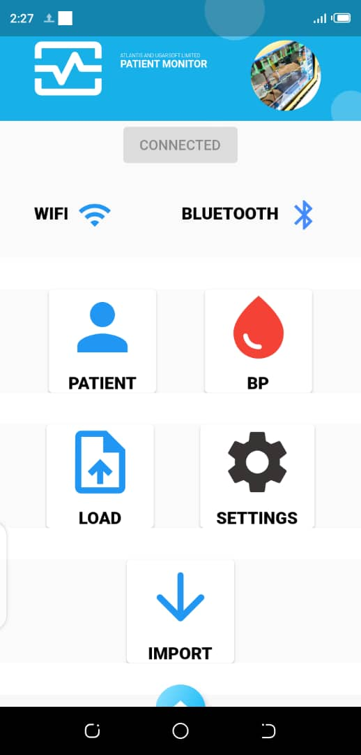
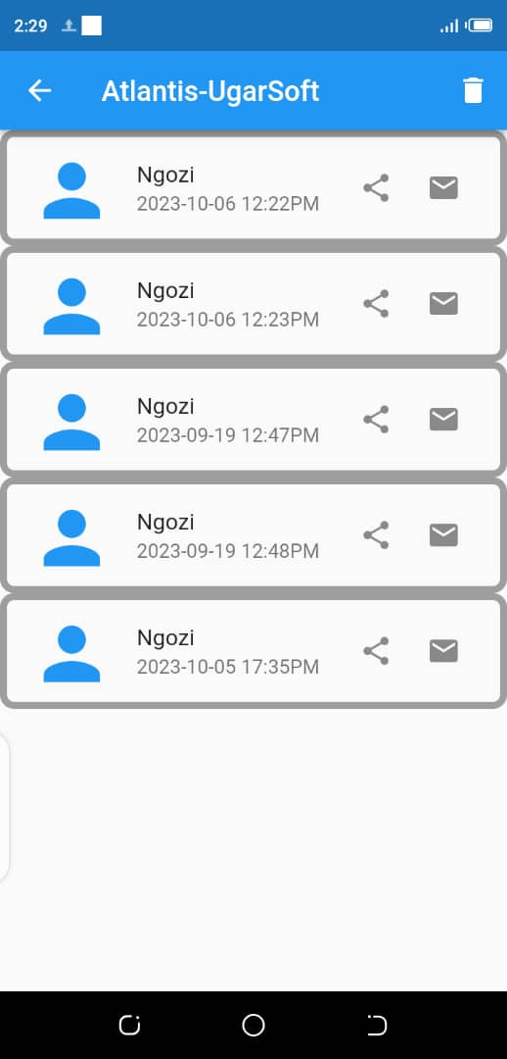
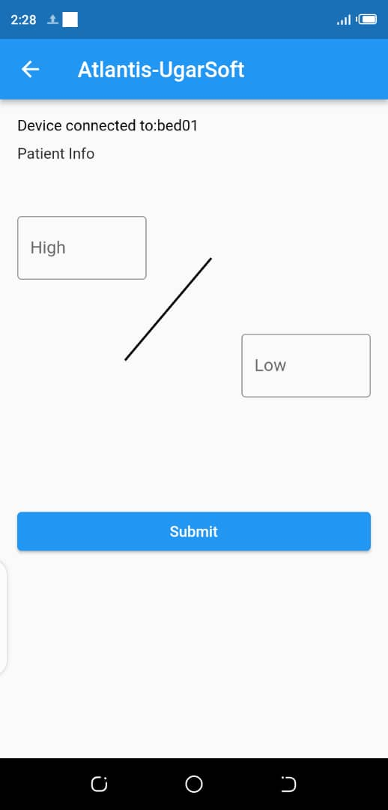
SOLUTION USER INTERFACE

Slide 7
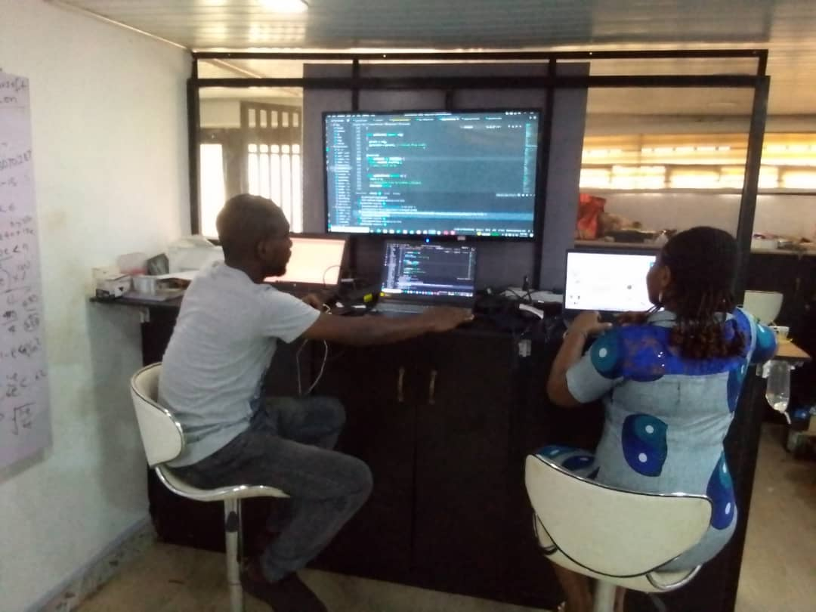
OUR MISSION
To provide low cost, open source solution to hospital and medical personnel in urban and rural areas of Africa.

Slide 8
MARKET OPPORTUNITIES
Our product will be used by thousands of small, medium and large hospitals throughout Africa and the Global South, due to its reliability, versatility and low cost.

Slide 9
OUR TEAM

